Slide 1

AIOps: Intelligent Incident Resolution
Discover our Agentic AI Platform, designed to revolutionize incident management with advanced automation and intelligent problem-solving capabilities.

Slide 2


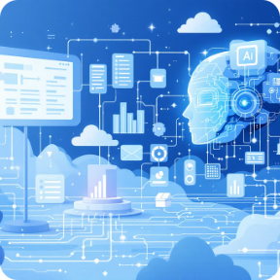
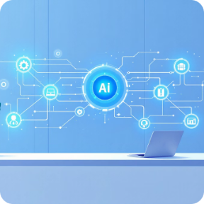
Our Agentic AI Platform Features
Multi-Agent Orchestration
Autonomous Investigation
Context-Aware Analysis
Actionable Outcomes
Specialized AI agents work together seamlessly to tackle complex issues.
Self-directed problem-solving, reducing manual effort and accelerating resolution.
Generates concrete fixes and solutions, not just reports, for immediate impact.
Deep understanding of code, logs, and infrastructure for precise diagnostics.

Slide 3

AIOps Capability Matrix
1. Incident Triage
2. Error Analysis
Auto-detect issues
Log correlation
Priority scoring
Application-wide scan
1-2 day error aggregation
Pattern recognition
3. Root Cause Analysis
4. Automated Fix
Code analysis
Stack trace parsing
Timeline reconstruction
Generate code fixes
Create Pull Requests
Hotfix scripts

Slide 4

AIOps Capability Matrix (Continued)
5. Rally Integration
6. GCP Alerts
Defect sync
SFDC ID mapping
One-click analysis
Alert aggregation
Incident creation
Automated triage

Slide 5
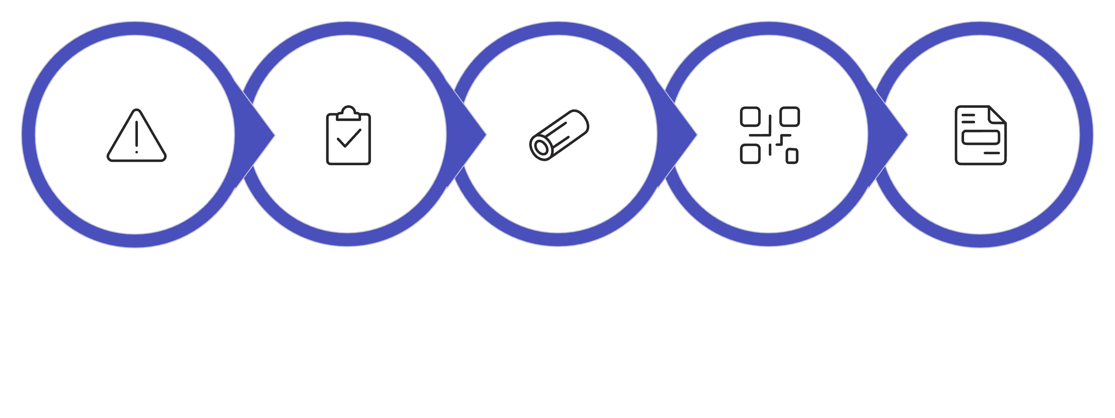


From Alert to Fix: Complete Automation
Code Analysis
Alert
Triage
Log Search
RCA Report
Our platform automates the entire incident resolution lifecycle, from initial alert detection to final deployment of the fix. Human involvement is only required at the Pull Request review stage.
HUMAN INVOLVEMENT: Only at PR Review Stage!

Slide 6

User Journey: Analyst Workflow
Day in the Life of an Operations Analyst
01
02
Morning Triage
During Investigation
Open AIOps Dashboard, view overnight alerts (auto-aggregated from GCP), review auto-generated incident list, and click "Start Analysis" on critical items. AI agents investigate automatically.
Receive real-time progress updates, view log analysis results, review code analysis findings, read AI-generated RCA report, and review proposed fix.
03
Resolution
Utilize one-click PR creation, review generated code changes, approve and merge, deploy the fix, and close the incident.

Slide 7

Capability 1: Intelligent Issue Triage
Our platform provides automated incident detection and prioritization, ensuring critical issues are addressed swiftly and efficiently.
Smart Classification
Automatically categorizes incidents for streamlined management.
Deduplication
Groups related errors to prevent alert fatigue and redundant efforts.
Impact Assessment
Identifies affected services and users to gauge the severity of an incident.
SLA Tracking
Prioritizes incidents based on business impact and service level agreements.

Slide 8


Capability 2 & 3: Log and Code Analysis Agents
Log Analysis Agent
Code Analysis Agent
Our dedicated agent efficiently processes and correlates log data to identify anomalies and potential issues, providing crucial insights for incident investigation.
This agent performs in-depth code analysis, correlating stack traces to source code and analyzing recent commits to pinpoint the root cause of errors.

Slide 9

Key Features: RCA & Fix Generation
Container-to-Repository Mapping
Stack Trace to Source Code Correlation
Seamlessly links container issues to their corresponding code repositories.
Directly connects error messages to the exact lines of code for rapid debugging.
Recent Commit Analysis
AI-Powered Code Review
Analyzes recent code changes to identify potential culprits for new incidents.
Automated review of generated fixes ensures quality and adherence to standards.

